Slide 1
Module 6: Lesson 3 Analytic Cluster Patterns

Slide 2
Analytic Clusters
Computing systems which support HDFS, YARN, the MapReduce Execution Engine, the Spark Execution Engine or similar data processing technologies
Analytic Cluster Patterns:
Coupled Storage and Compute Cluster
Uncoupled Storage and Compute Cluster
Persistent Cluster
Transient Cluster

Slide 3
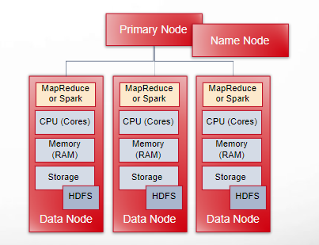
Coupled Compute and Storage Cluster
Represents the traditional Hadoop architecture
Storage and processing capabilities are tightly integrated within the same nodes
As a result compute and storage must be scaled together
The cluster must be persistent or otherwise the data (HDFS) becomes inaccessible

Slide 4
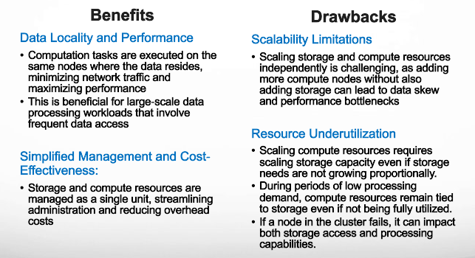
Coupled Compute and Storage Cluster

Slide 5
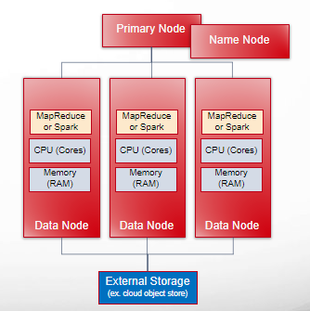
Decoupled Compute and Storage Cluster
Represents a mostly cloud centric extension of the traditional Hadoop architecture
Storage and processing capabilities are separated into distinct systems
This allows storage and compute to be scaled and managed independently
Data resides in a separate storage system, such as a cloud-based object store like Amazon S3, Azure Data Lake Storage, or Google Cloud Storage

Slide 6
Decoupled Compute and Storage Cluster
Benefits
Enables more efficient resource (storage, compute) management, to match specific workload demands
Drawbacks
Latency and bandwidth limitations can impact performance, especially for workloads with high data transfer requirements
Cloud (centralized) storage offer advanced features like data protection, replication, versioning, and access controls, leading to better data governance

Slide 7
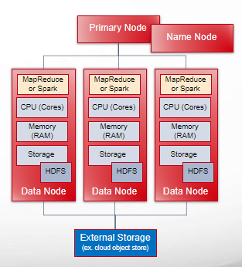
Hybrid Compute and Storage Cluster
Another mostly cloud centric extension of the traditional Hadoop architecture
Extends the decoupled compute and storage cluster with coupled storage (HDFS)
Coupled node storage (HDFS) is used for temporary or working data and an object store is used for long term data
One realization of this pattern is the AWS EMR service which offers node local HDFS and access to S3

Slide 8
Coupled Versus Decoupled Versus Hybrid Clusters
Decoupled clusters offer greater flexibility, scalability, but computation throughput may be negatively impacted by lower performance external storage and network latency and throughput limitations
Coupled clusters provide high performance for data-intensive workloads due to data locality but are less flexible and scalable and must be persistent
Hybrid clusters offer a user a tunable balance between high performance and flexibility

Slide 9
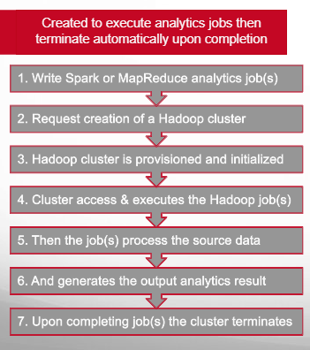
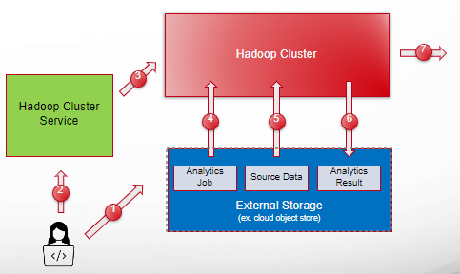
Transient Cluster

Slide 10
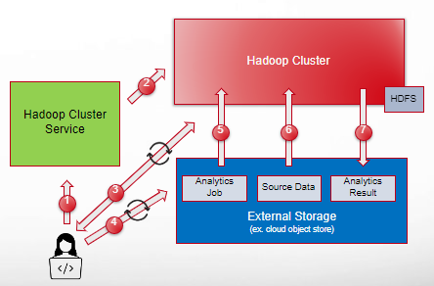
Persistent Cluster
Runs continuously, even when not actively processing jobs
1. Request creation of a Hadoop cluster
2. Hadoop cluster is provisioned and initialized
3. Issue and execute interactive queries
4. Write one or more analytics job(s)
5. Cluster access & executes the Hadoop job(s)
6. Then the job(s) process the source data
7. And generates the output analytics result

Slide 11
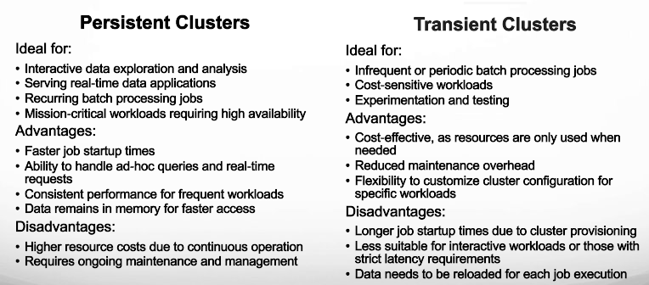
Decoupled Compute and Storage Cluster

